Slide 1
Stats140 Multivariate Analysis
Final Project
Owen Lin
Eric(Yu) Zhao
Louis Chu

Slide 2
Dataset: Dry Bean
This dataset can be find in the UCI Machine Learning Repository:
https://archive-beta.ics.uci.edu/dataset/602/dry+bean+dataset
Bean images obtained by high resolution camera and analysis with computer vision system
13,611 grains of 7 different registered dry beans
16 features: 12 dimensions and 4 shape forms
The shape forms are calculated with formulas utilizing the existing data
Eg. ShapeFactor3 = 4*Area/(Major_Axis_Length^2*π)

Slide 3
Table of Contents
1
2
3
4
Exploratory Data Analysis
Supervised Learning
Unsupervised Learning
Comparison

Slide 4
Exploratory Data Analysis

Slide 5
Features In the Dataset
1.) Area (A): The area of a bean zone and the number of pixels within its boundaries.
2.) Perimeter (P): Bean circumference is defined as the length of its border.
3.) Major axis length (L): The distance between the ends of the longest line that can be drawn from a bean.
4.) Minor axis length (l): The longest line that can be drawn from the bean while standing perpendicular to the main axis.
5.) Aspect ratio (K): Defines the relationship between L and l.
6.) Eccentricity (Ec): Eccentricity of the ellipse having the same moments as the region.
7.) Convex area (C): Number of pixels in the smallest convex polygon that can contain the area of a bean seed.
8.) Equivalent diameter (Ed): The diameter of a circle having the same area as a bean seed area.
9.) Extent (Ex): The ratio of the pixels in the bounding box to the bean area.
10.)Solidity (S): Also known as convexity. The ratio of the pixels in the convex shell to those found in beans.
11.) Roundness (R): Calculated with the following formula: (4piA)/(P^2)
12.) Compactness (CO): Measures the roundness of an object: Ed/L
13-16.) Shape Factors 1-4 (SF1-4)

Slide 6
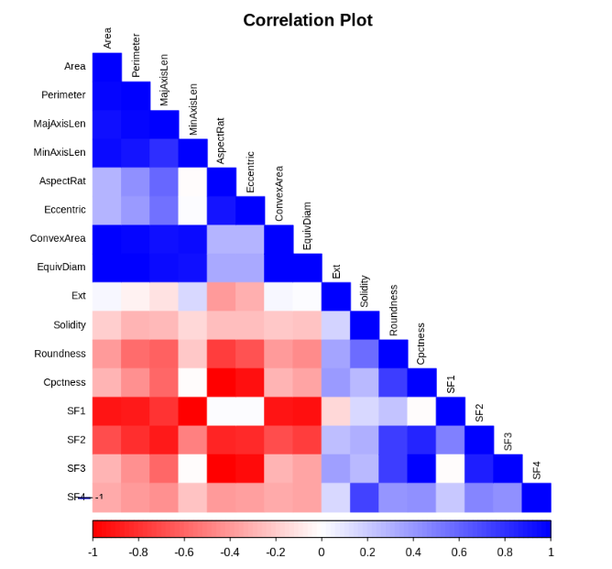
The Correlation Matrix on the Full Dataset
Many features are strongly correlated with another features.
Some features are ratio transformations of other observed data

Slide 7
Selected Features
1) Area (A): The area of a bean zone and the number of pixels within its boundaries.
2) Perimeter (P): Bean circumference is defined as the length of its border.
3) Major axis length (L): The distance between the ends of the longest line that can be drawn from a bean.
4) Minor axis length (l): The longest line that can be drawn from the bean while standing perpendicular to the main axis.
5) Eccentricity (Ec): Eccentricity of the ellipse having the same moments as the region.
6) Convex area (C): Number of pixels in the smallest convex polygon that can contain the area of a bean seed.
7) Extent (Ex): The ratio of the pixels in the bounding box to the bean area.
8) Solidity (S): Also known as convexity. The ratio of the pixels in the convex shell to those found in beans.
9) Roundness (R): Calculated with the following formula: (4*A)/(P^2)
Notes:
Roundness is the only feature we kept that is the result of the transformation
It seems to represent a different aspect of the beans

Slide 8
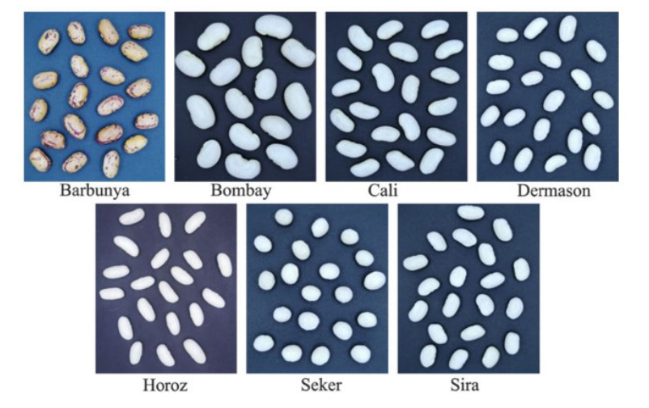
Notes:
chose these four classes of beans because they seem to exhibit different features.
For example, the top left bean is brown-ish with some red stripes on it, and the Seker on the bottom middle is the most rounded bean.
We expect the classification and clustering method to be very efficient on this subdataset where the difference can be identified with human eyes.
Color of the bean is not part of the feature, it’s categorical

Slide 9
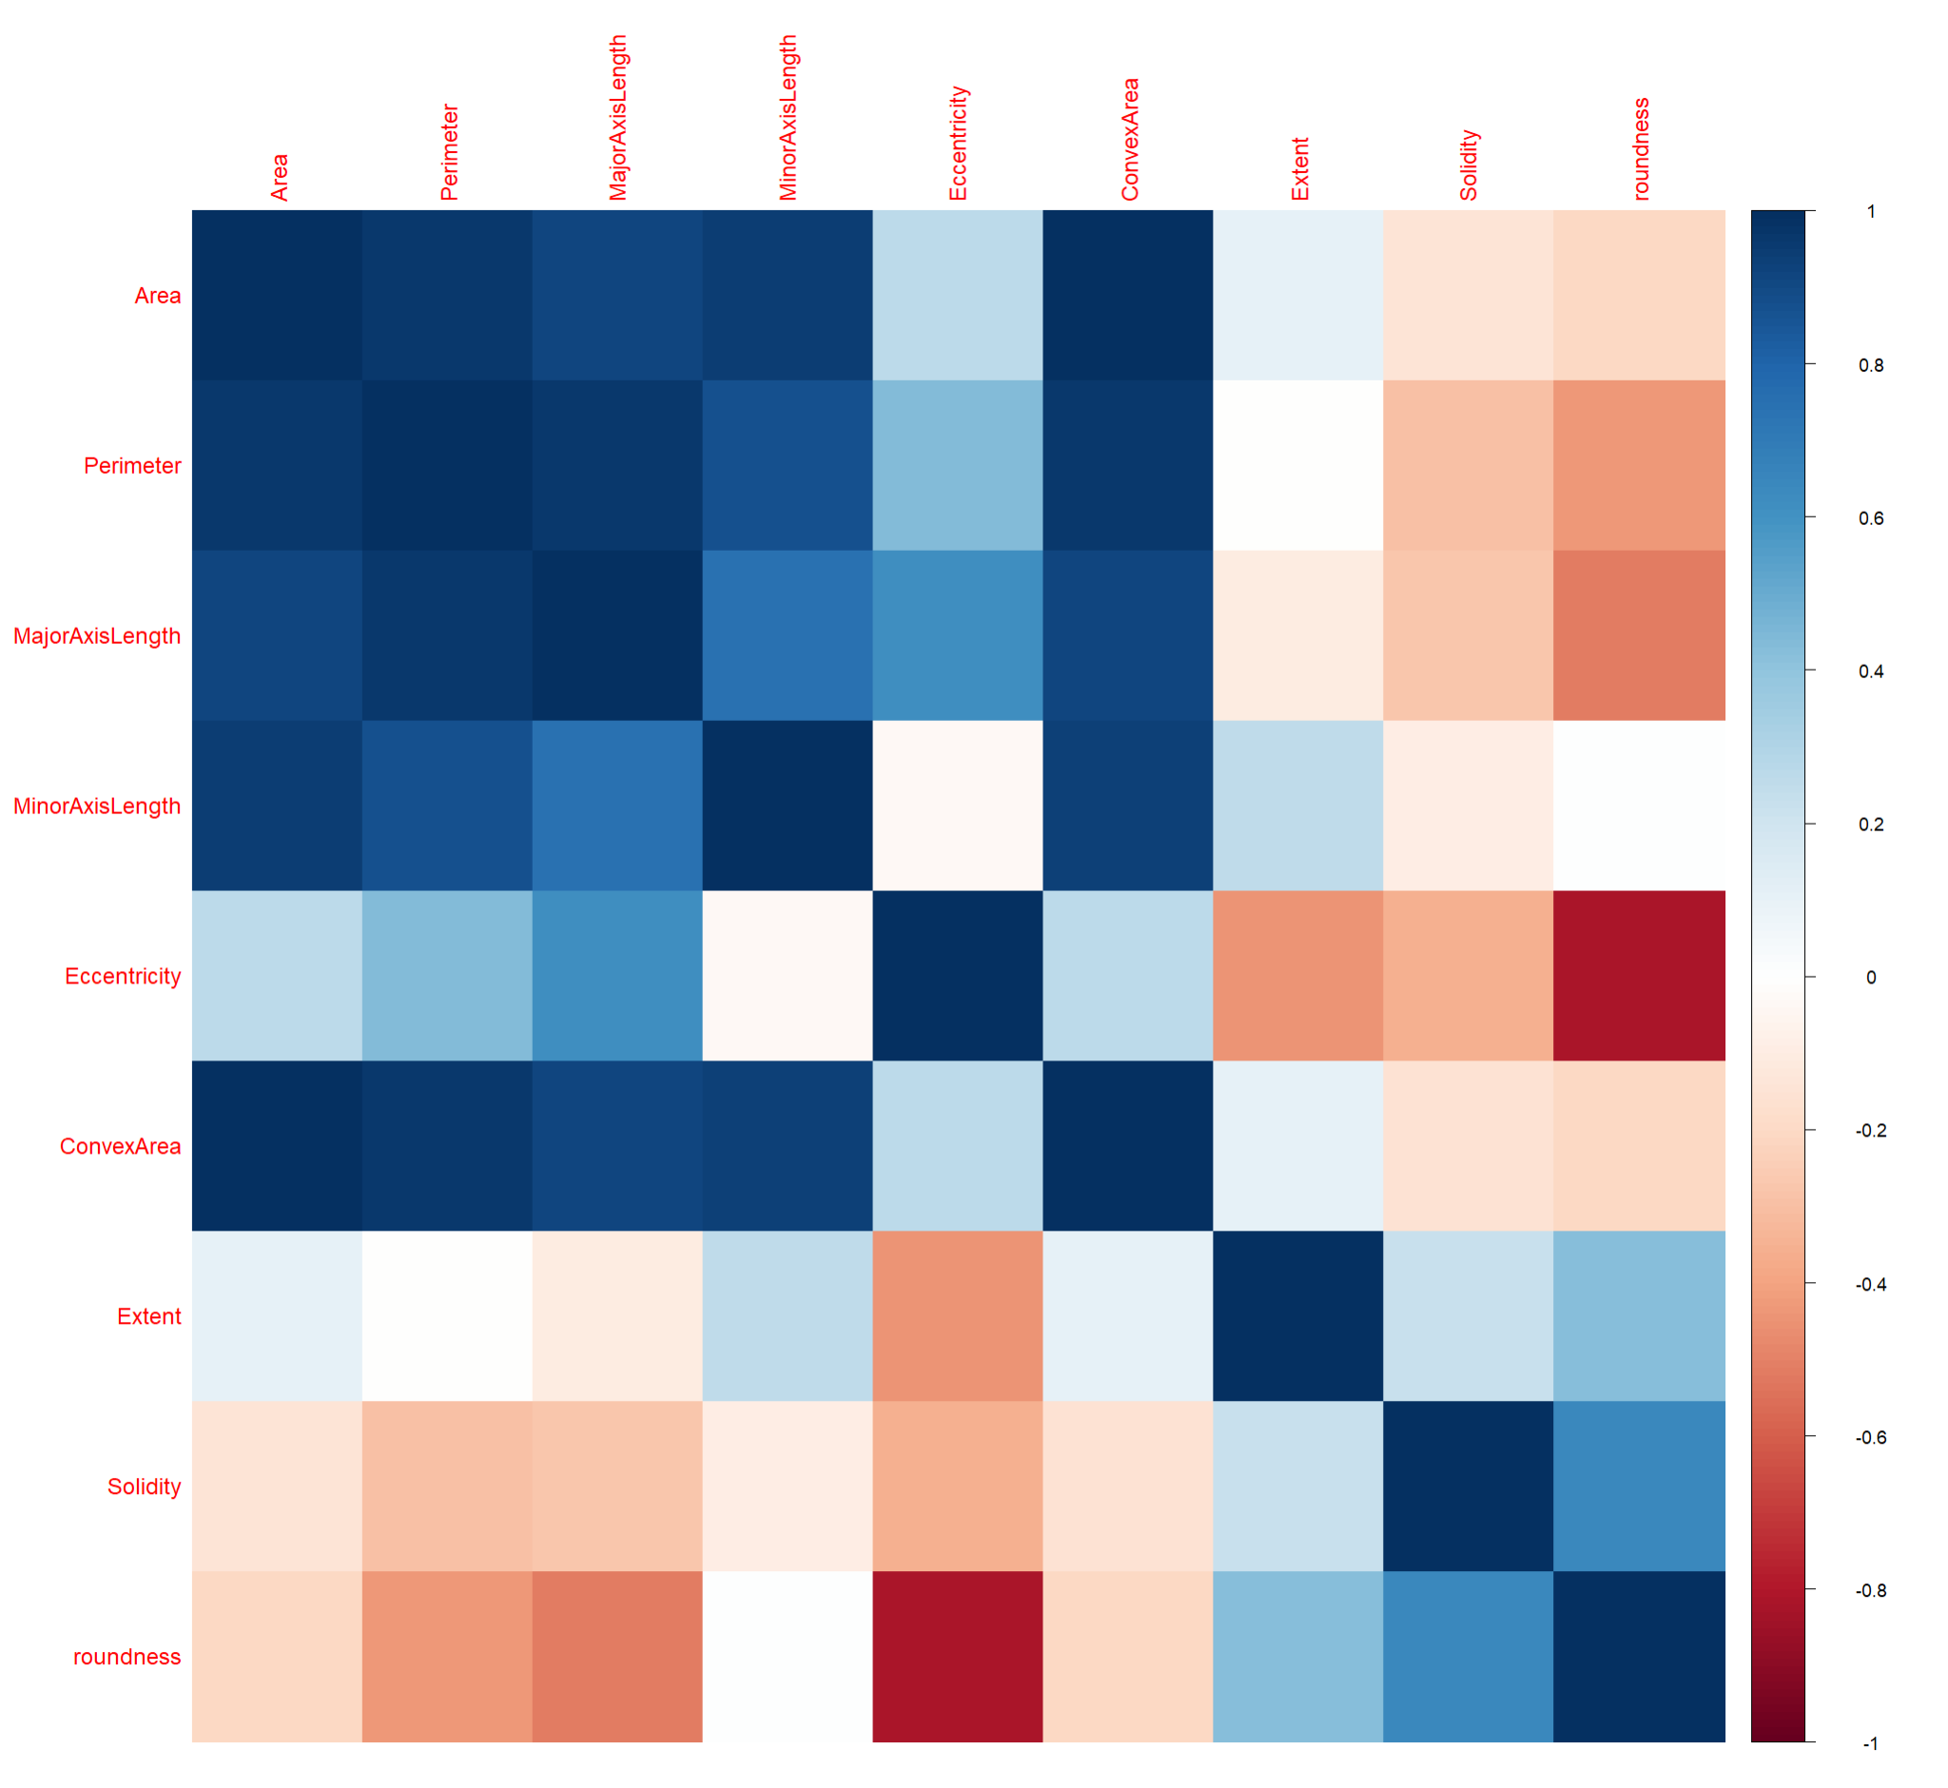
Correlation Plot of the Processed Dataset
13611 x 17 ==> 5799 x 10
4 Classes of Bean and 9 features
Class | n
Barbunya | 1322
Bombay | 522
Horoz | 1928
Seker | 2027
Notes:
Unbalanced data - but not too extreme
Mimics the structure of Iris data we used in class
All the features are continuous variables with no missing data in this dataset.
The processed data consists of 4 classes of bean and 10 features.

Slide 10
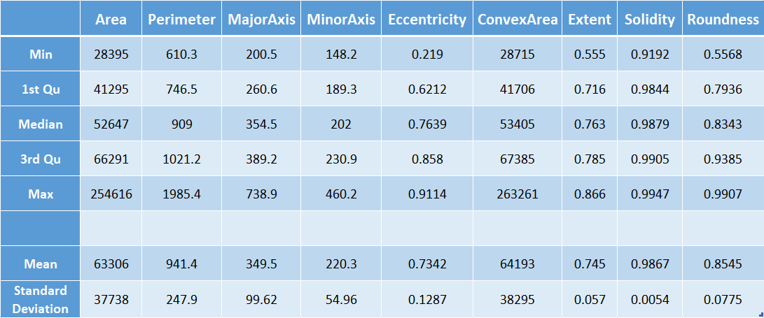
Descriptive statistics
Notes:
From the descriptive statistics, we can see that there are many outliers in the data.
In the Area column, the maximum is over 250 thousand while the mean is around 63 thousands with a standard deviation of 37 thousands.
The maximum value is approximately 5 standard deviation above the mean
The scale of the data varies quite a bit in the data, this is due to the difference in measurement unit.

Slide 11
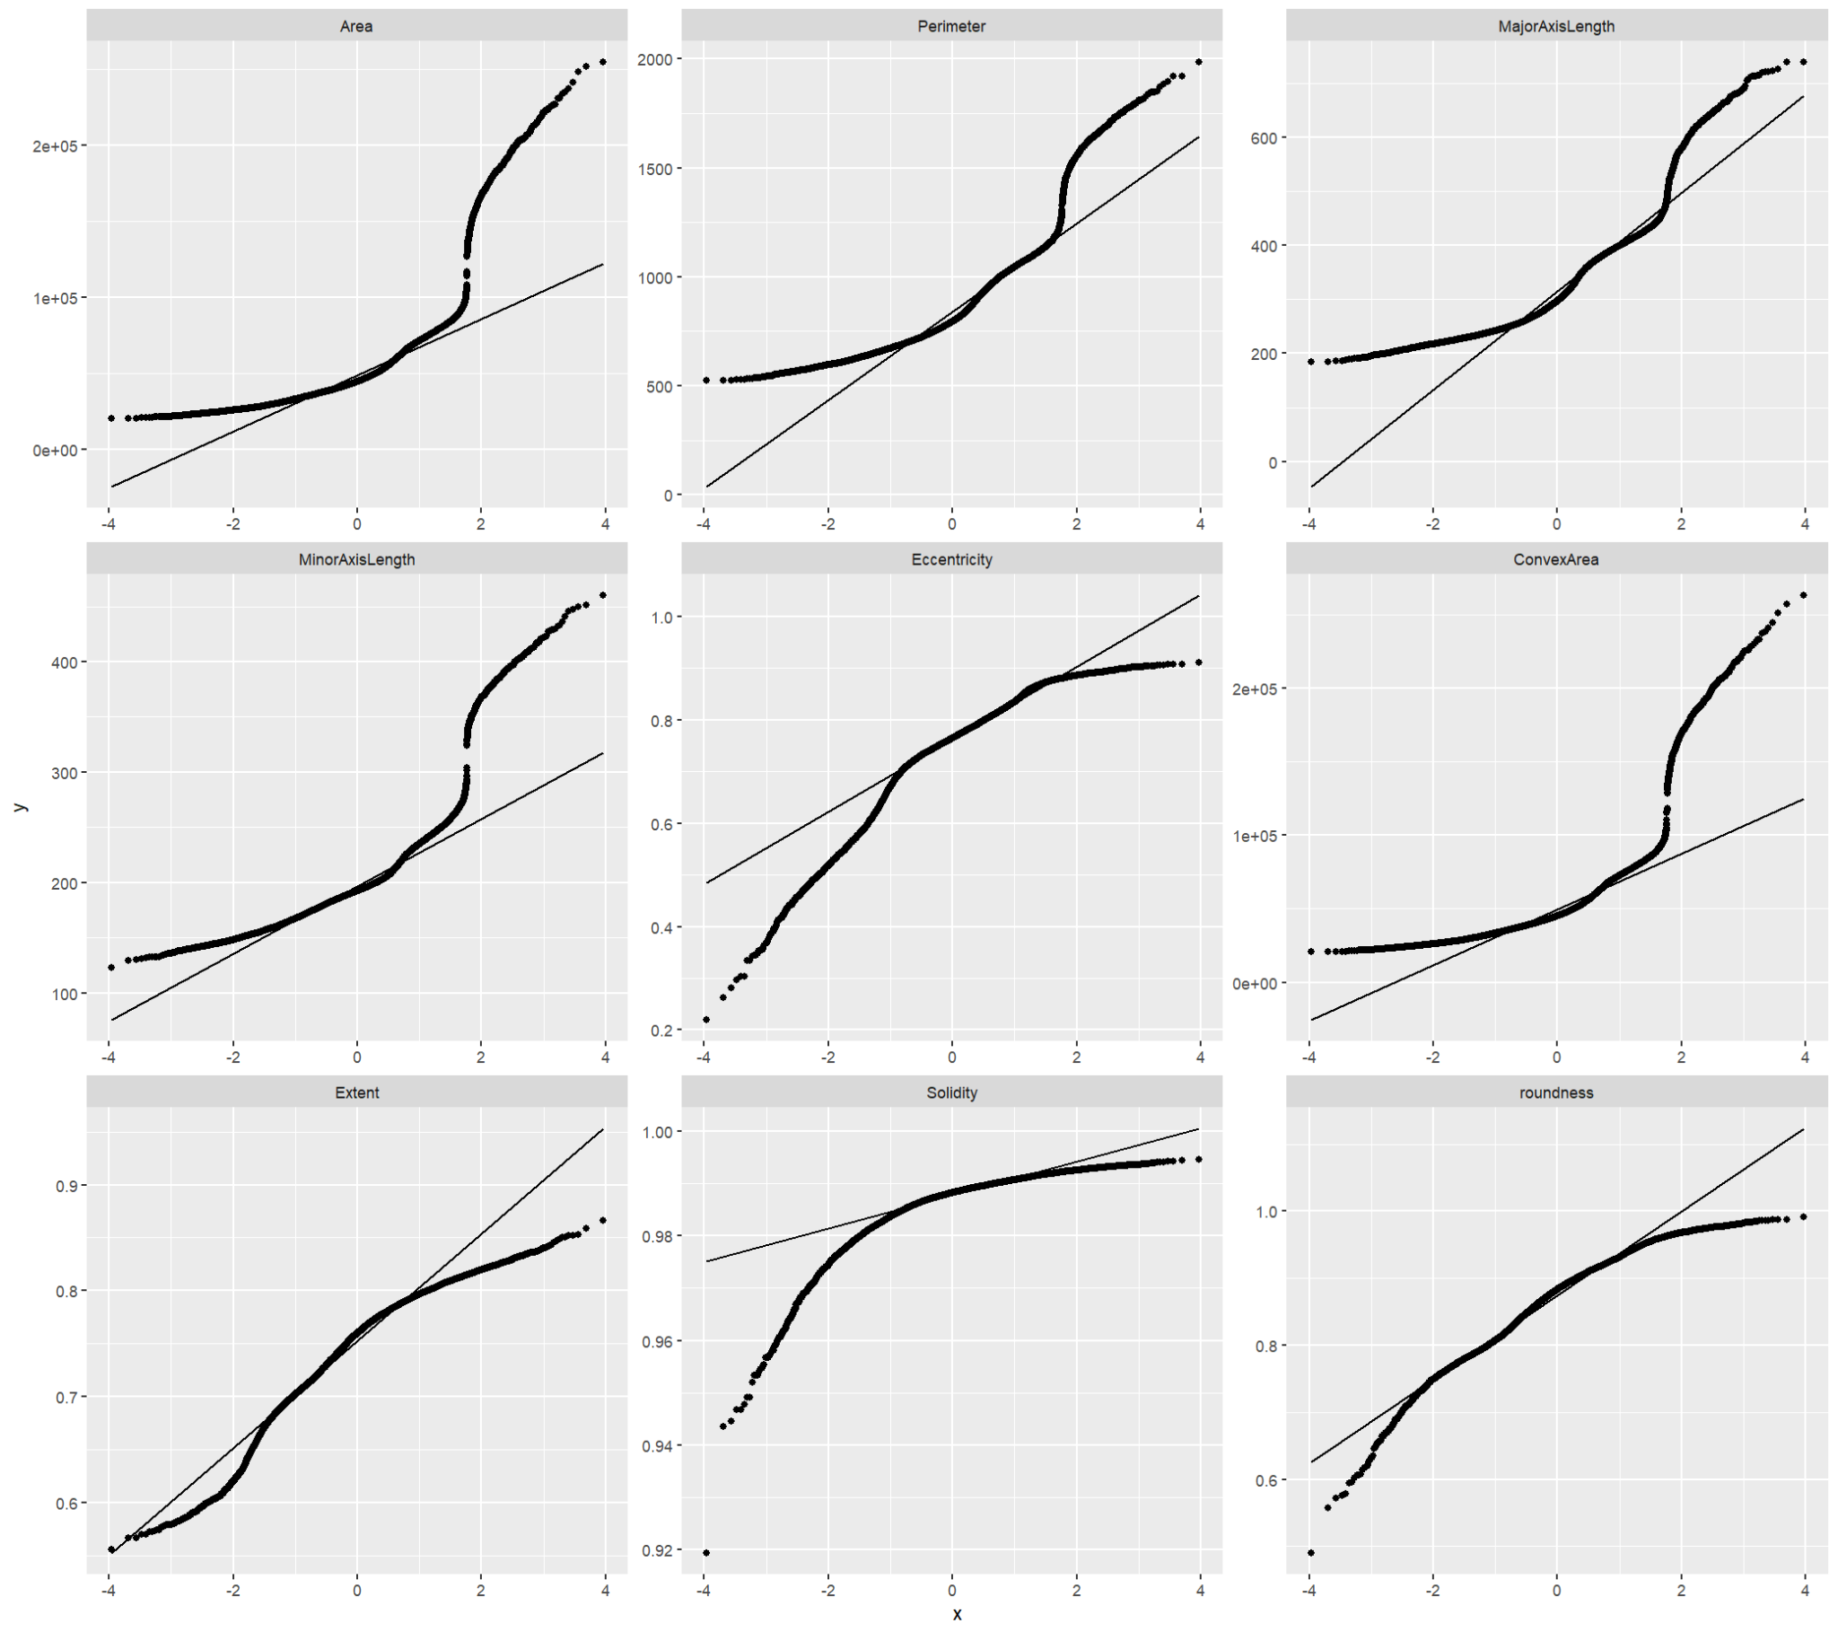
QQ-plots
All features deviate greatly from the theoretical quantiles

Slide 12
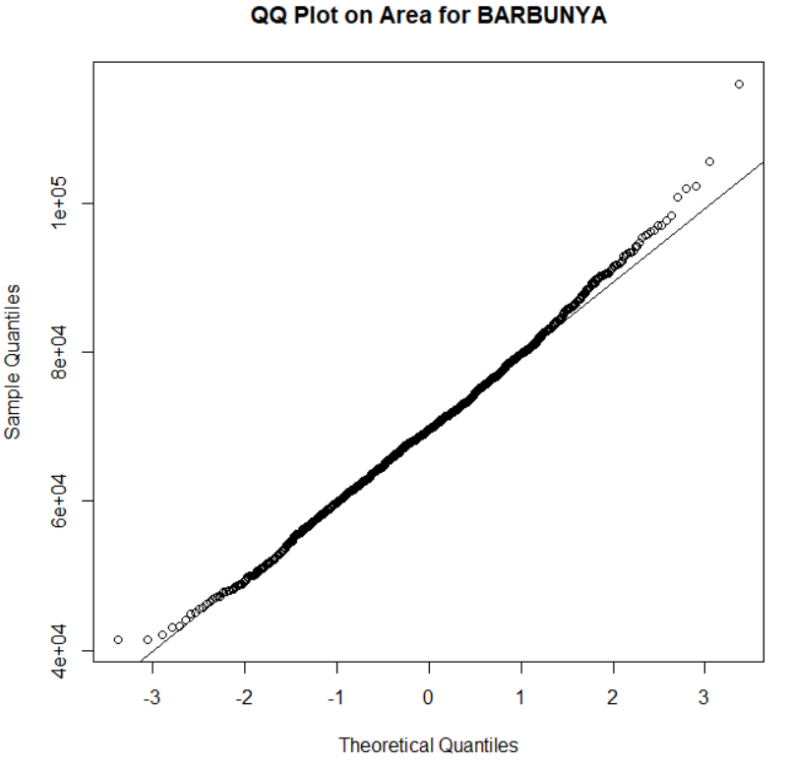
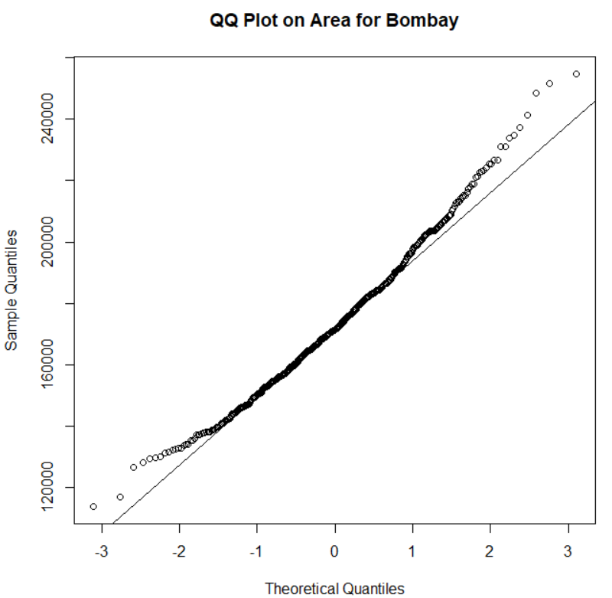
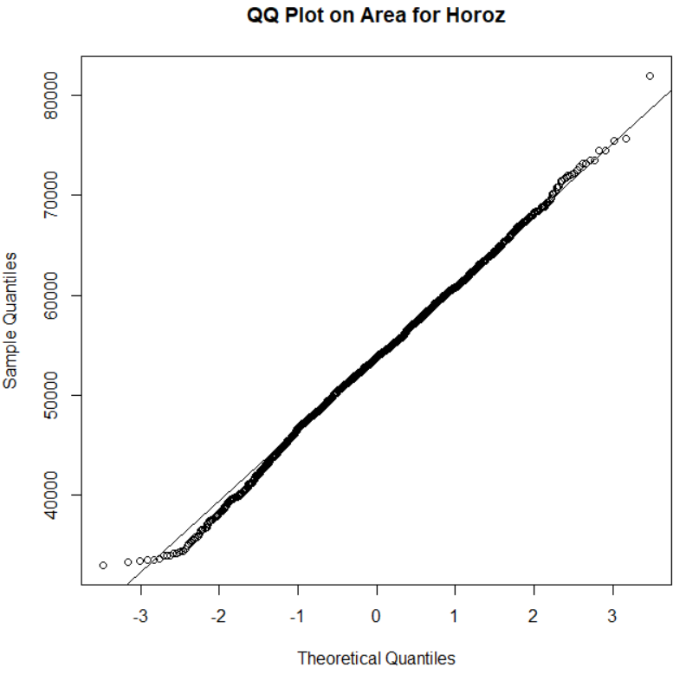
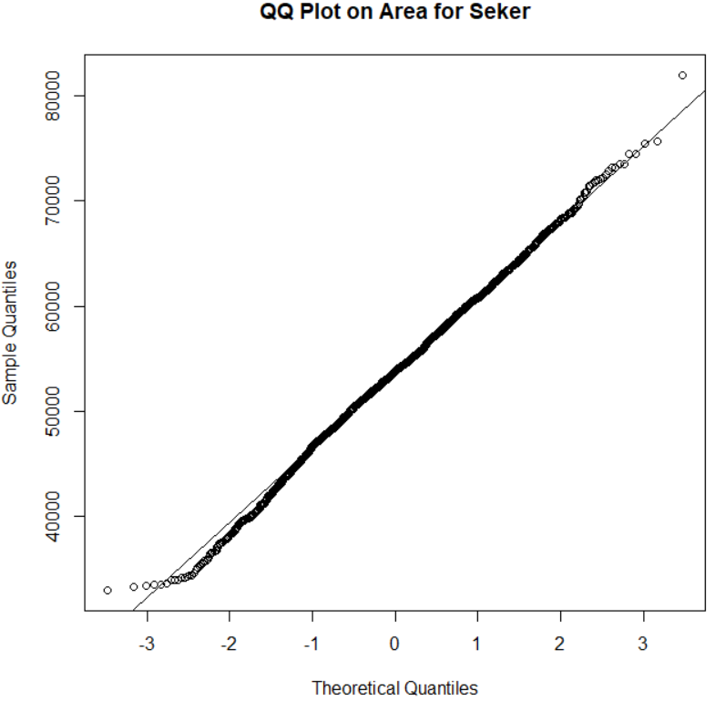
QQ-plot of Area by Class
The feature looks much more normal within a class
Signifies that the classification and the clustering techniques will be effective

Slide 13
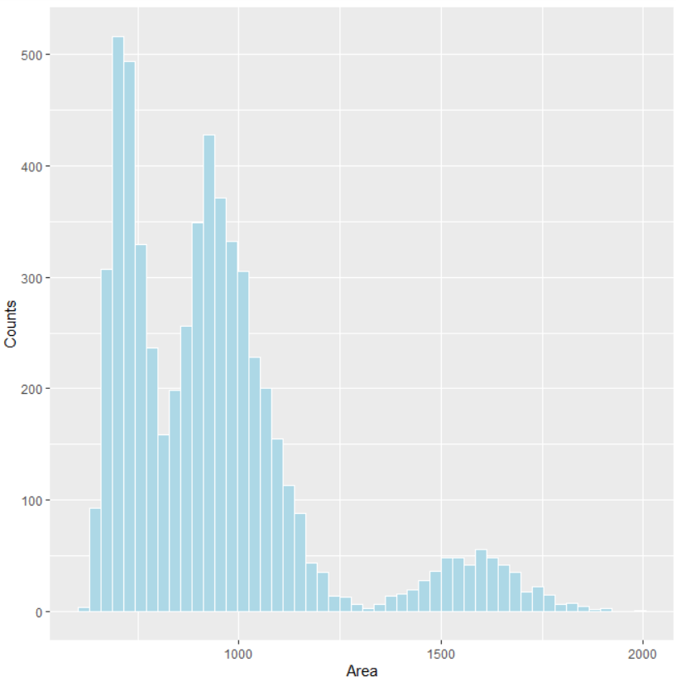
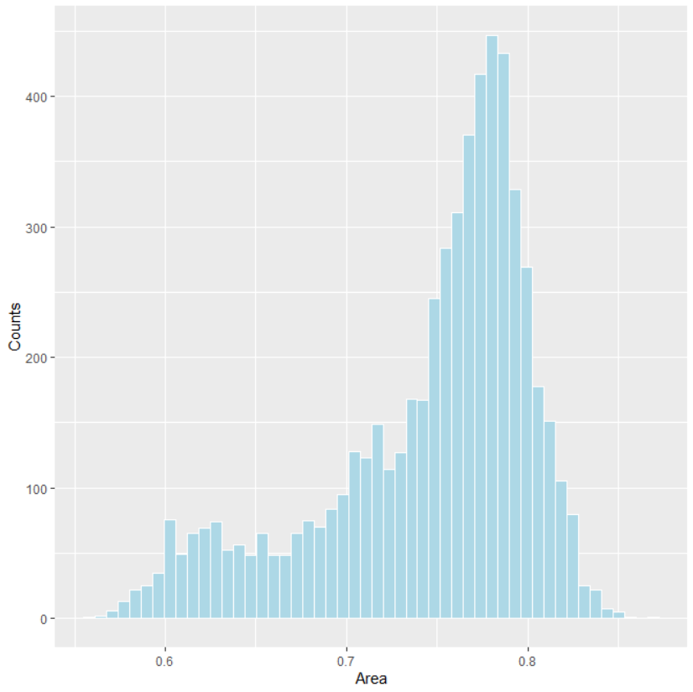
Histogram for Perimeter
Histogram for Roundness

Slide 14
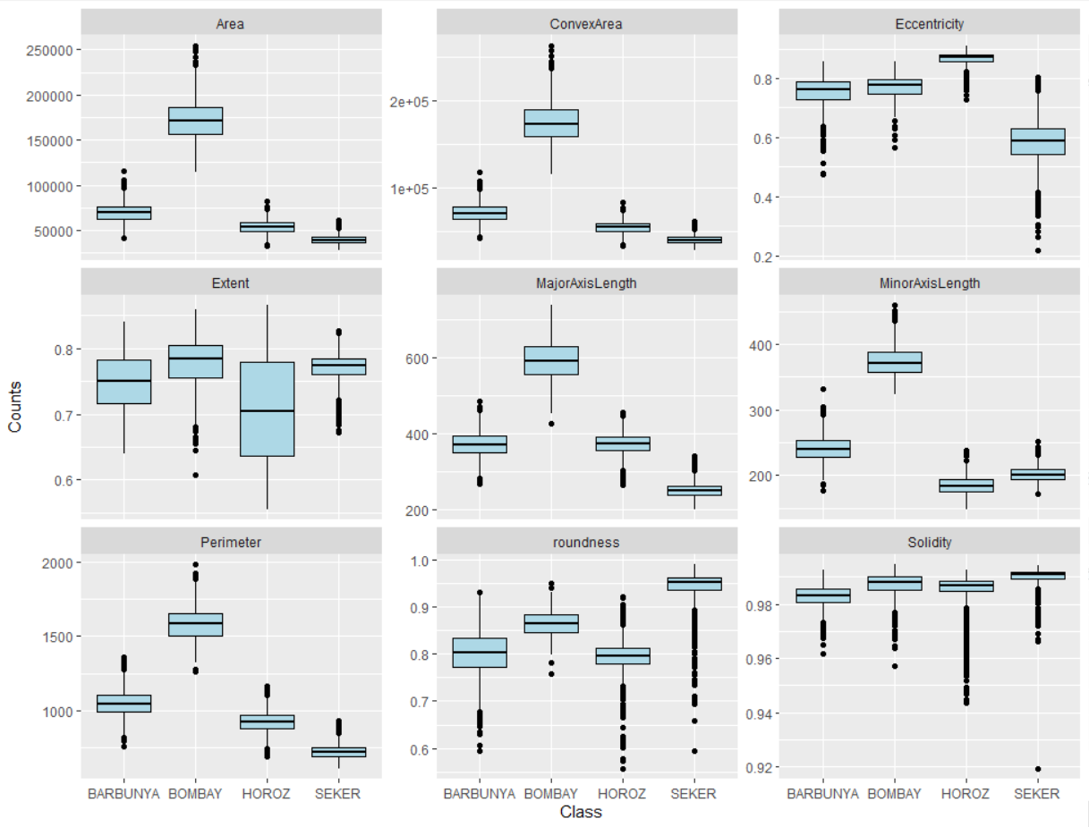
Boxplot of ALL Features by Class
Outliers are still presented
In certain features, the difference between class are easy to observe
Bombay in Area
SEKER in roundness

Slide 15
Supervised Learning
- KNN

Slide 16
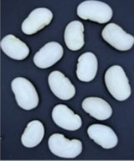
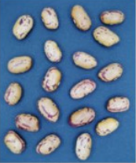
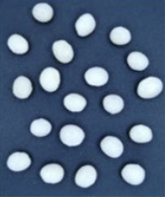
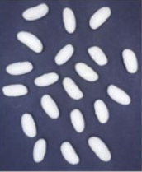
Label Data
9%
22.8%
Bombay
Barbunya
36%
Seker
33.2%
Horoz
Notes:
From the pie chart, we can see that the subset sample we selected are unbalanced. With 36% of the data being from the class Seker, 33.2% of the data from the class Horoz, 22.8% of the samples from Barbumya and 9% of the data being from Bombay.

Slide 17
Train Test Split
Training set
80%
Testing set
20%
Allows model evaluation
Performance comparison after tuning parameters
Avoids overfitting
Unbiased assessment
10-fold cross-validation
Notes:
We’ve randomly selected 80% of the data to be from the training set and 20% of the data to be the testing set. Such split are a common practice among the machine learning community. In addition, we have also setup the model to perform cross-validation. In the case of our study, we just picked 10 fold, meaning that the data will divide the training dataset to 10 folds and perform training and validation on the data to better train and model them.

Slide 18
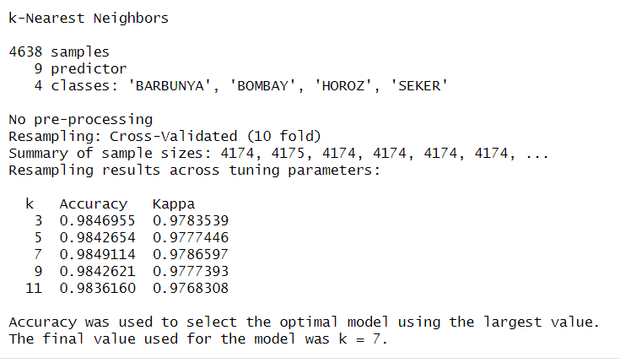
KNN Classification
98.49%
K = 7
Yields the highest accuracy
Notes:
As shown in the figure, we have about 4638 samples with 9 predictors and 4 classes. We have a resampling of the cross validation of 10 fold. And for the number of neighbors k, we picked 3, 5, 7, 9, and 11. We just picked these numbers for convenience and the results relatively similar for every single one of them. As you can see, they all seem to hover at around 98% accuracy and they only start to differ at the third to fourth decimal place. And the result for the best accuracy is 98.49% of being 7 neighbors. We are not completely sure of how Kappa works. But the general idea is that it is a more informative evaluation metric aside from accuracy and it takes into consideration of an unbalanced date. Hence, it is more trustworthy to look at the Kappa value. However, in our case, the kappa value doesn’t seem to deviate much from the accuracy score as it is around 0.97

Slide 19
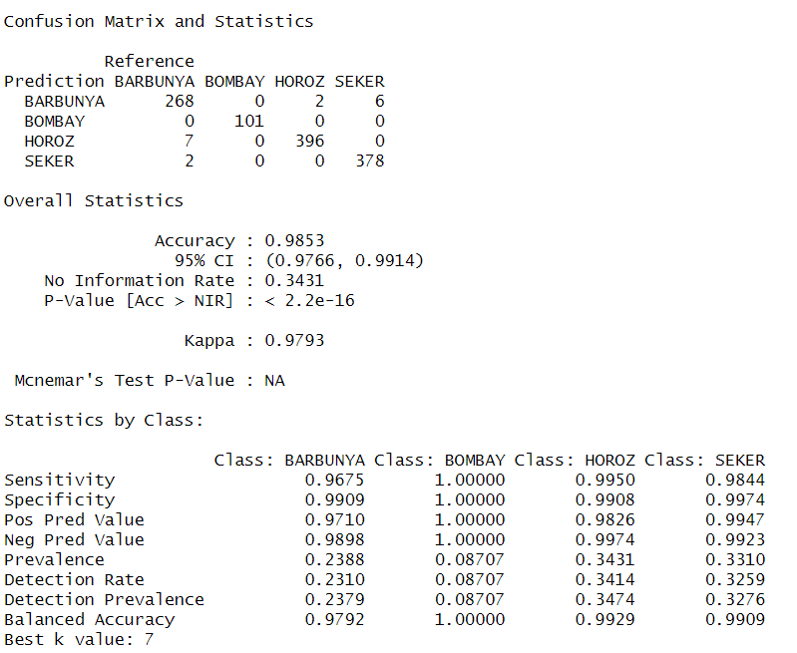
Confusion Matrix & Statistics
Notes:
Let’s take a look at the confusion matrix of our model. We do see that Bombay has the least number of testing data. However, we achieved a 100% accuracy in categorizing a new bean as Bombay. The most misclassificstion occurred on the Barbumya with 7 of them being predicted as Horoz and 2 of them being predicted as Seker
Sensitivity: Also known as True Positive Rate or Recall, it measures the proportion of actual positive instances (samples belonging to a specific class) that are correctly identified by the model. (Vertical 387 / (387 + 5 + 4))
Specificity: It measures the proportion of actual negative instances (samples not belonging to a specific class) that are correctly identified by the model.
Positive Predictive Value: Also known as Precision, it represents the proportion of instances classified as positive that are truly positive (Horizontal, 387 / (387 + 13 + 3))
Negative Predictive Value: It represents the proportion of instances classified as negative that are truly negative.
Prevalence: It is the proportion of instances in the dataset that belong to a specific class.
Detection Rate: It is the proportion of instances correctly classified as positive out of all the instances that truly belong to a specific class.
Detection Prevalence: It is the proportion of instances correctly classified as positive out of all the instances classified as positive.
Balanced Accuracy: It is the average of Sensitivity and Specificity and provides an overall measure of model performance that takes into account both true positive and true negative rates.

Slide 20
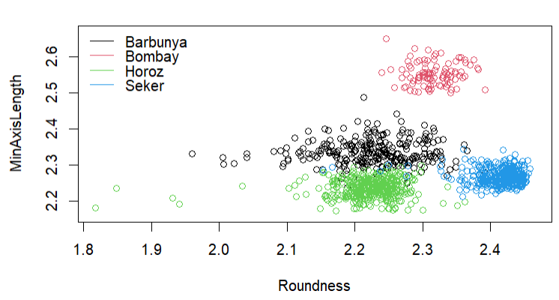
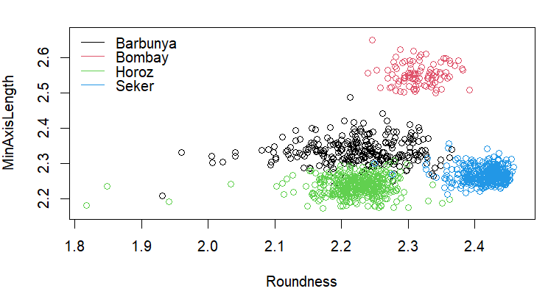
True Label
vs Classification Result
Notes:
The reason we picked roundness and minor axis length to display was because of the weak correlation as mentioned previously, thus we expect the graph to look more even and balanced, which indeed, it is clear as to which clusters are where. On the left is the graph of the true label, whereas the right shows the points in which our model misclassified as.

Slide 21
Supervised Learning
- LDA

Slide 22
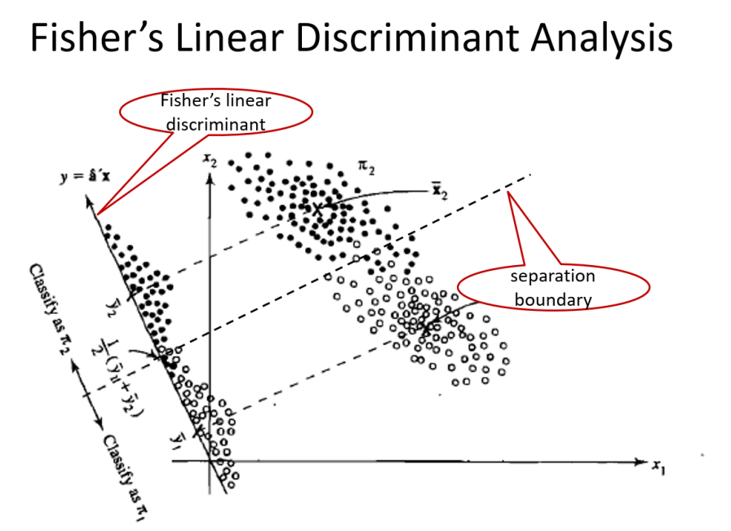
Given labels, we find the linear discriminants that maximize the separation of data
Notes:
A simple breakdown of the LDA is that given labels, we find the linear discriminants that maximize the separation of data.

Slide 23
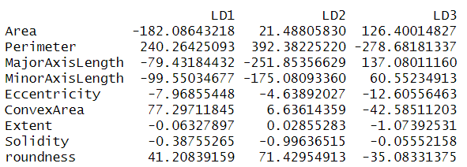
LDA Coefficient
LD1: Area and Perimeter
LD2: Perimeter and MajorAxisLength
LD3: Perimeter and MajorAxisLength
Most important component in terms of magnitude

Slide 24
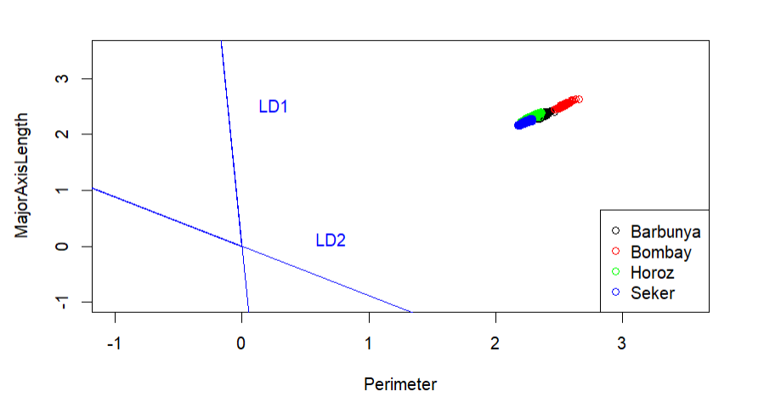
LDA Direction
LDA Projection:
Perimeter
MajorAxisLength

Slide 25
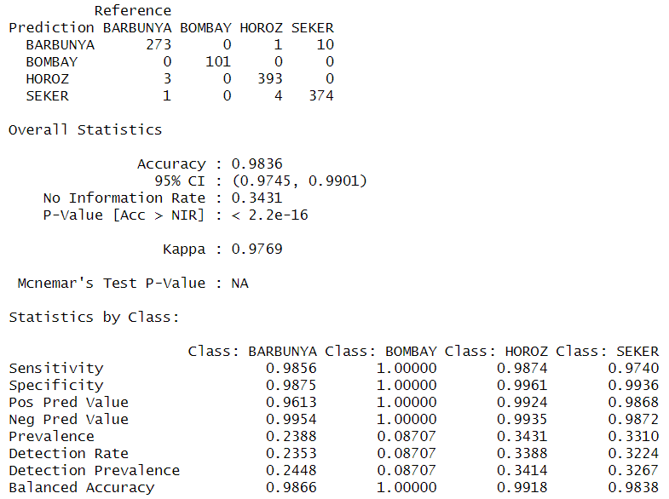
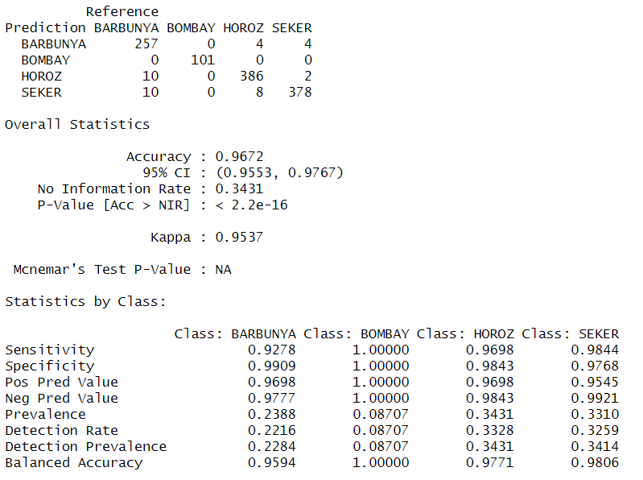
Using all features
Using Perimeter + MajAxisLen

Slide 26
Unsupervised Learning
- K means

Slide 27
“Unlabeled” Data
We can treat Dry Bean Dataset as unlabeled data and apply unsupervised learning techniques.
Pro:
Exploration of hidden patterns
Dimensionality reduction
Outlier detection
Cons
Loss of labeled information:
Mistake in cluster assignments
Evaluation and validation challenges
Notes:
Pros:
Exploration of hidden patterns: By ignoring the labels and treating the dataset as unlabeled, clustering techniques can help reveal hidden patterns or structures within the data. It allows you to explore different perspectives and potentially discover new insights that may not have been apparent when considering the labeled information alone.
Dimensionality reduction: Clustering techniques can be used for dimensionality reduction. Even if the dataset has labeled information, clustering can help identify redundant or irrelevant features by grouping similar points together. This can potentially improve the efficiency and effectiveness of subsequent modeling steps.
Anomaly detection: Clustering can be useful for identifying anomalies or outliers within the labeled dataset. By applying clustering techniques on the labeled data, any data points that do not conform to the majority cluster can be identified as potential anomalies. This can help in detecting unusual patterns or identifying data points that may have been mislabeled.
Cons:
Loss of labeled information: By disregarding the labeled information and treating the dataset as unlabeled, you are effectively discarding the knowledge provided by the labels. This can be disadvantageous if the labeled information is valuable and critical for understanding or solving the problem at hand.
Unreliable cluster assignments: Clustering algorithms assign data points to clusters based on the similarity of their features. However, these cluster assignments may not necessarily align with the true class labels. The clusters obtained from an unlabeled dataset may not correspond to the intended classes or capture the same underlying concepts.
Evaluation and validation challenges: Evaluating the quality and validity of the resulting clusters can be challenging when there are no ground truth labels available. Without the labeled information, it becomes difficult to objectively assess the clustering results or compare them to any established benchmarks.

Slide 28
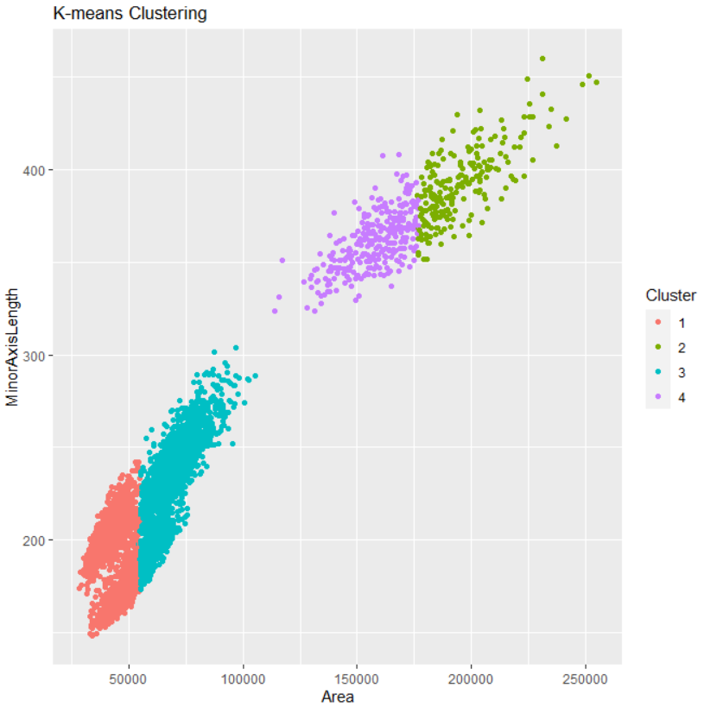
K Means
100 randomized starting points to ensure the clustering result
Chose 4 clusters based on prior knowledge
Without prior Knowledge, it can be argued that there are two clusters in this 2D plot

Slide 29
Unsupervised Learning
- PCA

Slide 30
Standardize the Data
Leading PCs tend to give larger loadings for features with large variance
The features are of different unit
Scaled to Mean 0 and Variance 1
Standardization changed the variance covariance matrix into the correlation matrix
Only centered the data yields identical results in PCA
PCA with covariance matrix and with correlation

Slide 31
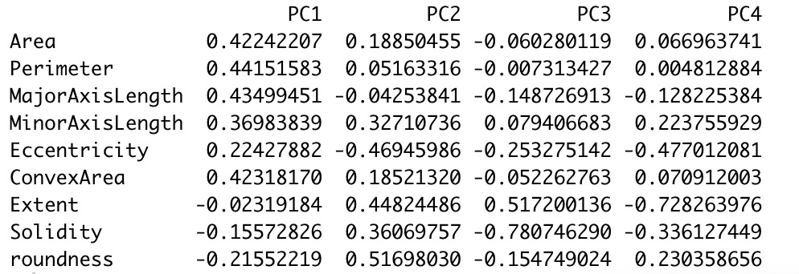
PCA loadings

Slide 32
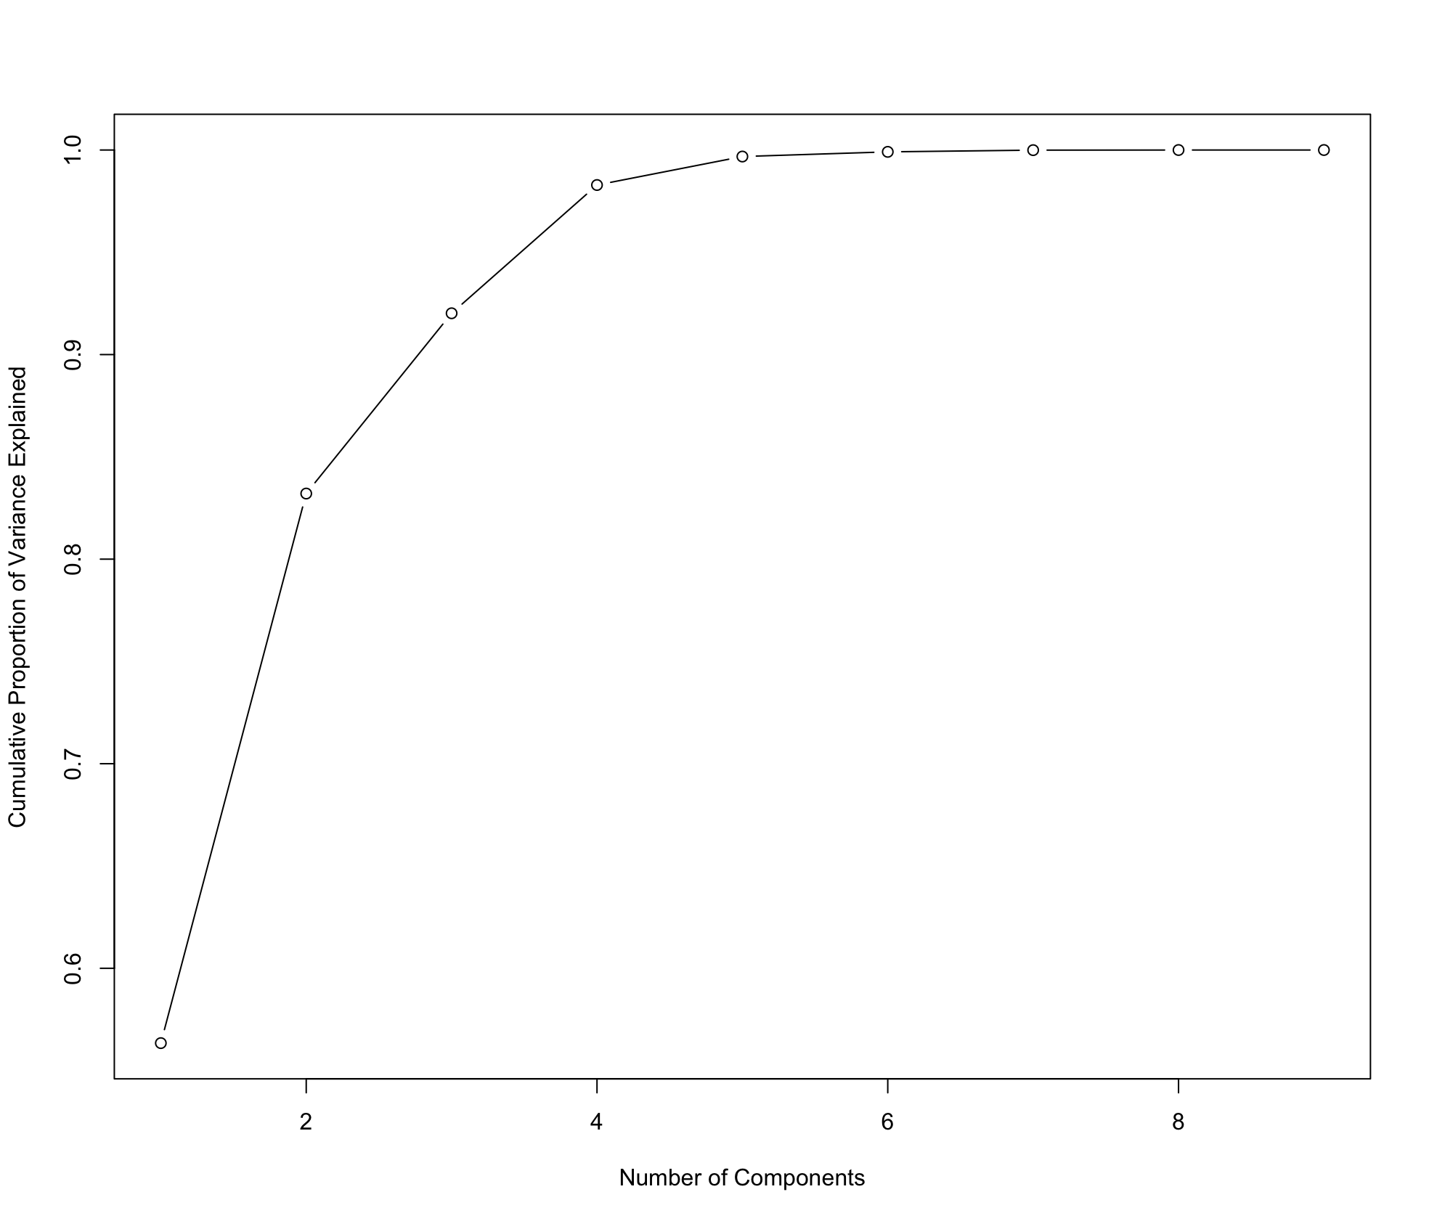
Number of Components
1st PC already explains more than 70% of the variance
4 components explain 95% of the variance
Notes:
pca$sdev^2 / sum(pca$sdev^2

Slide 33
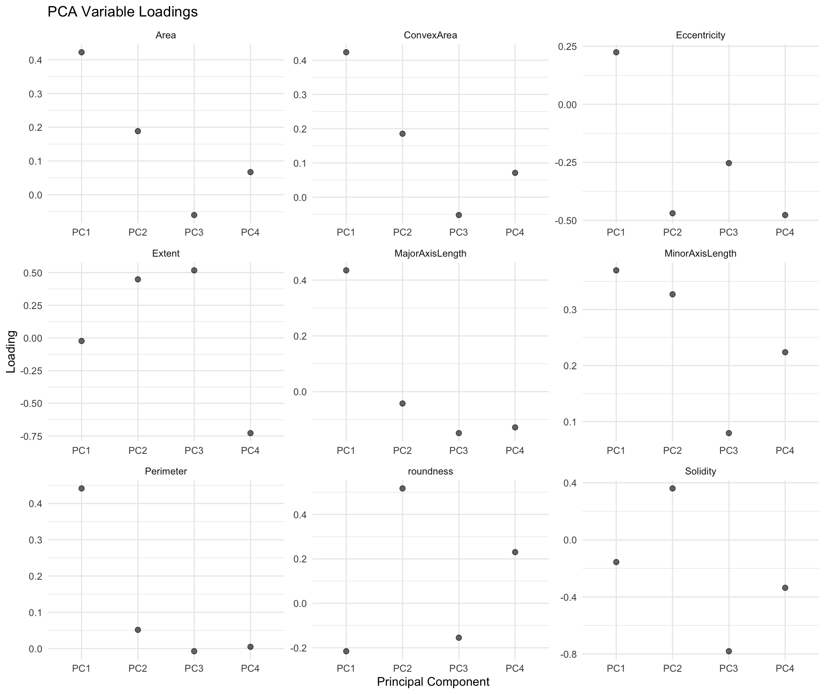
Components
Contribution
TO
Variable
Explanation

Slide 34
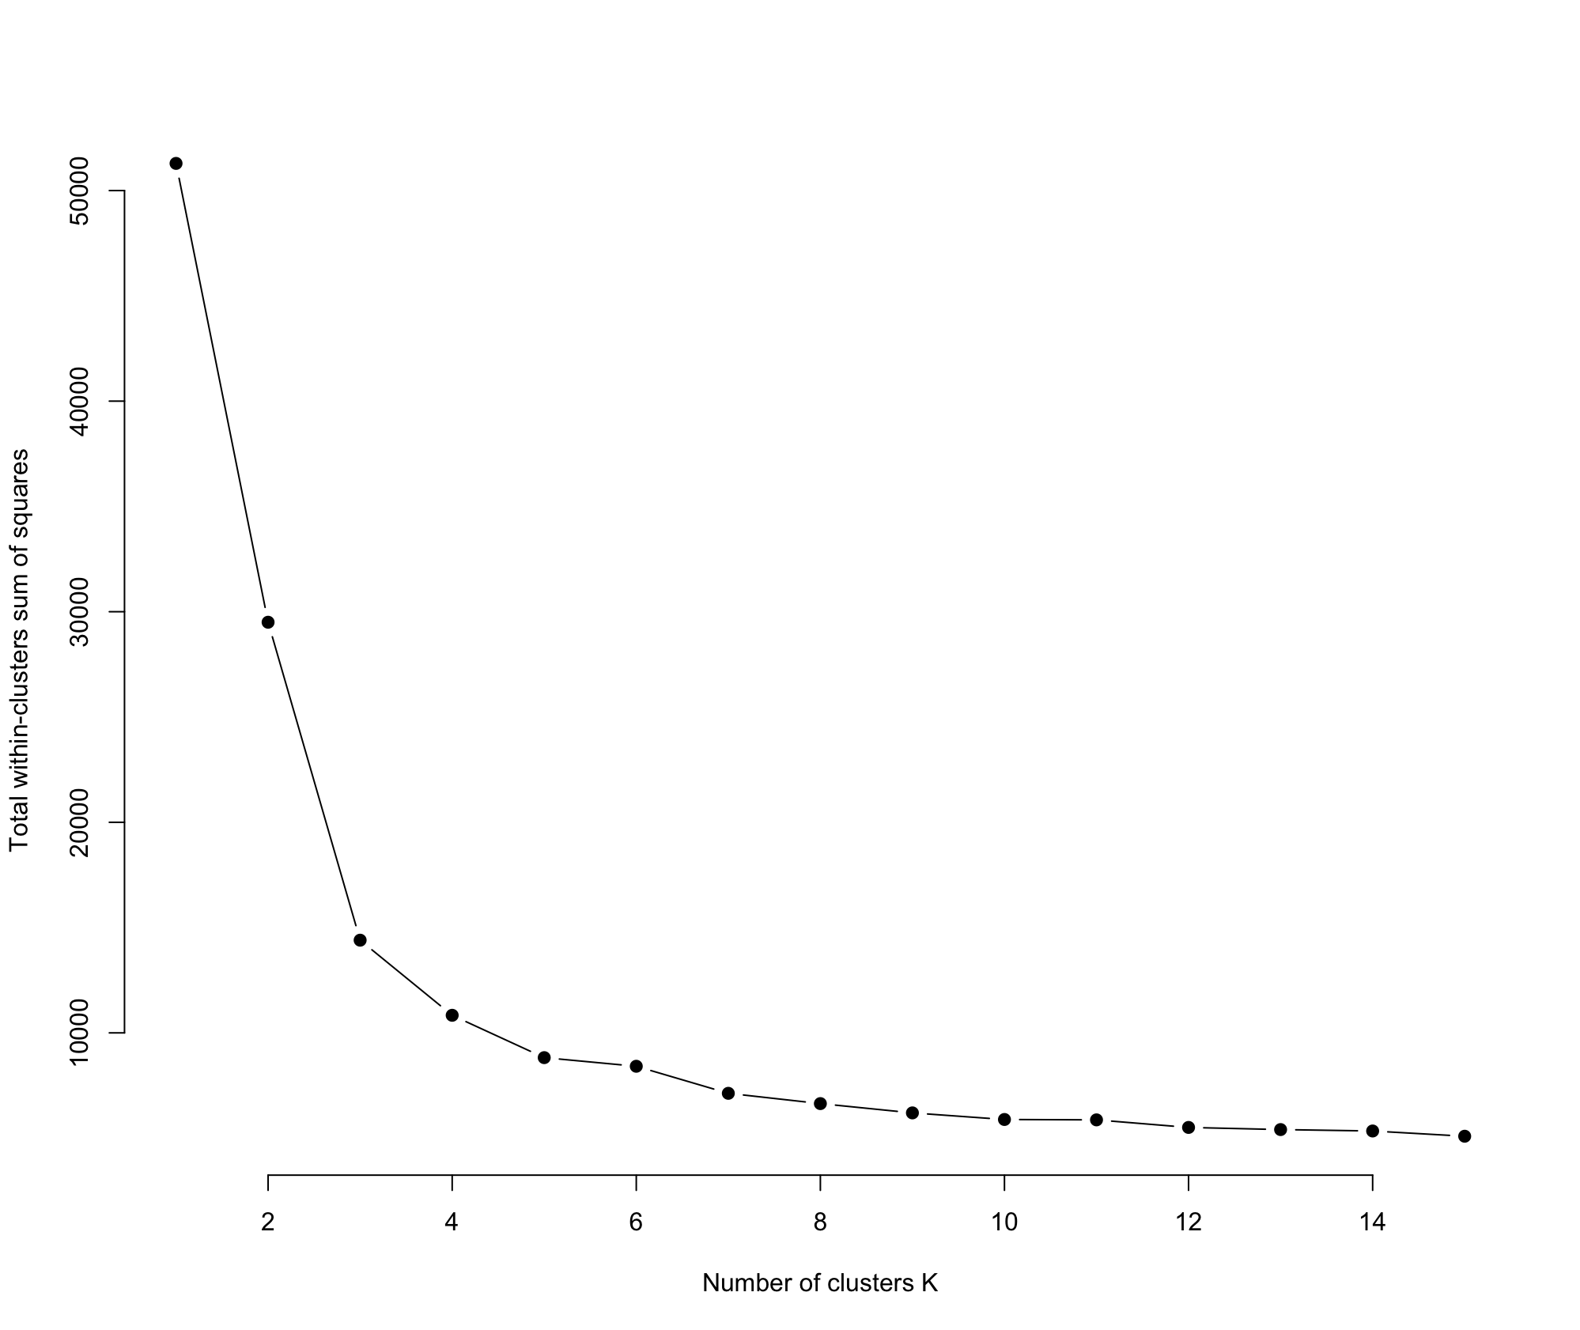
PCA -K mean Cluster
4 Clusters
Reason: Elbow Method
Elbow Method: calculate the sum of the squared distances from each member of a cluster to the centroid of that cluster

Slide 35
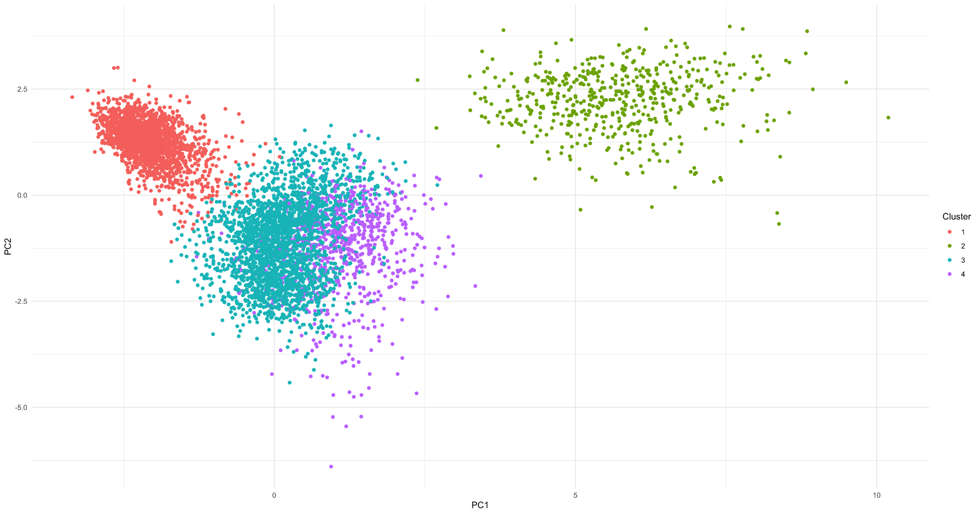
K-Mean Cluster Result
Drawback:
It is hard to explain the these 4 clusters after using PCA

Slide 36
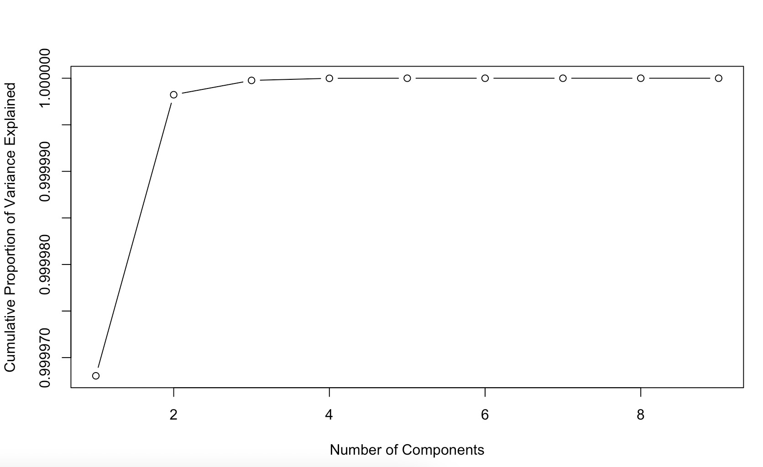
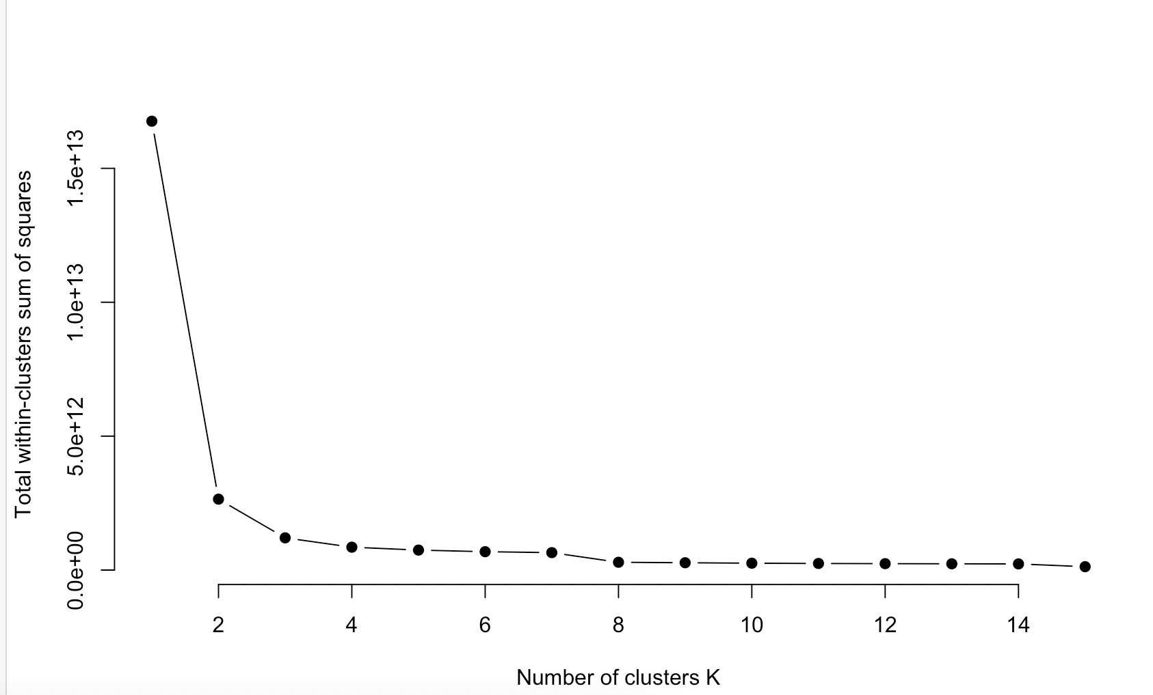
PCA, K mean With Normal Data

Slide 37
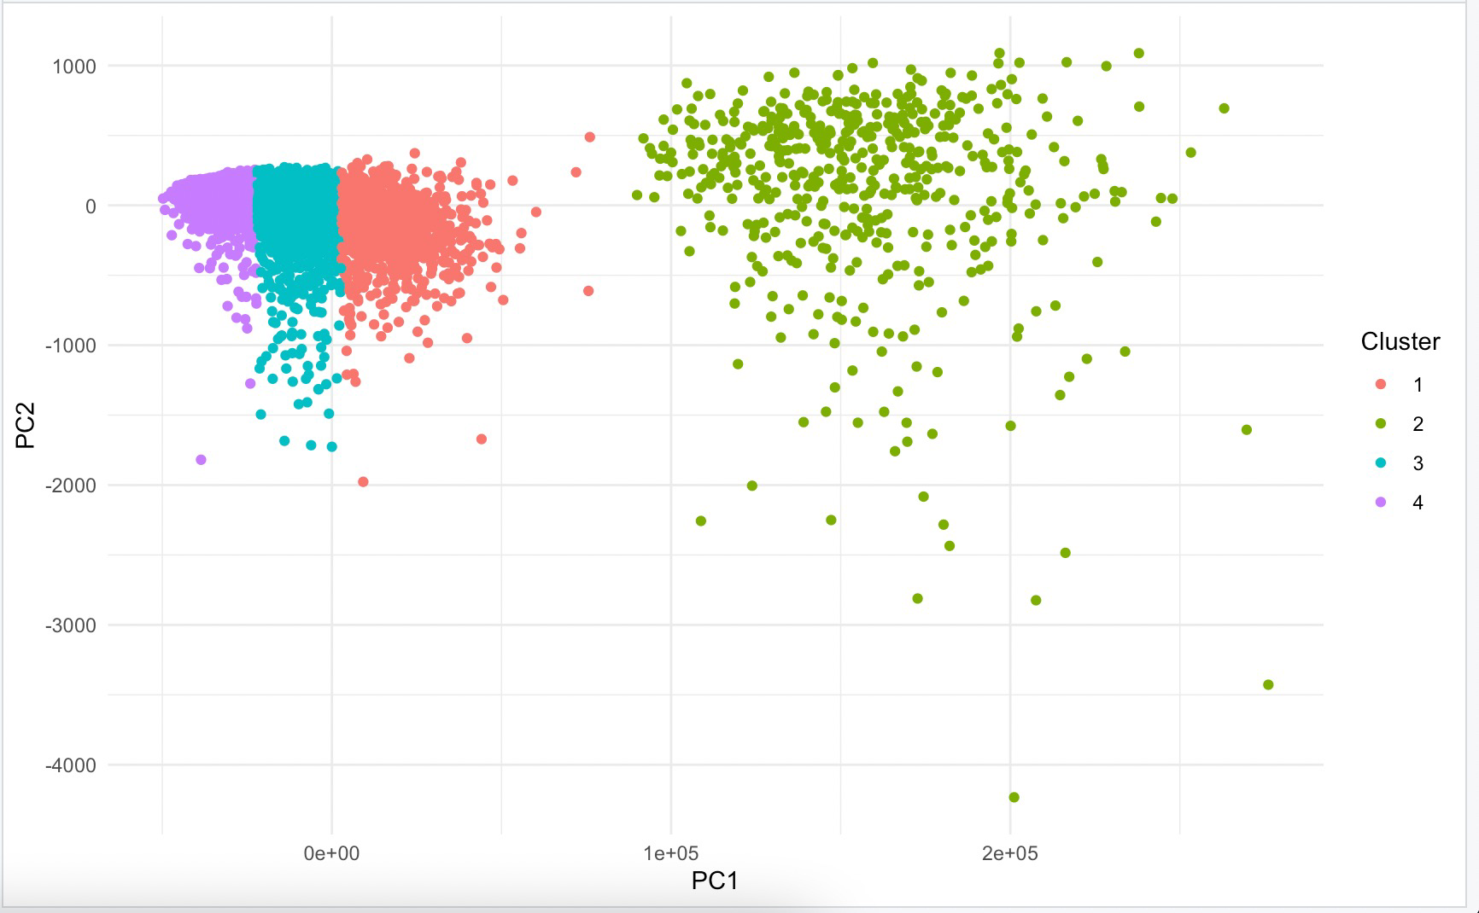

Slide 38
Comparison Between Standardized Data and Real Data
Used first 4 PCs to transform the data
Then used the pc_data to conduct kmeans
K-Means Cluster | BARBUNYA | BOMBAY | HOROZ | SEKER
True Label | 1332 | 522 | 1928 | 2027
standardized PCA | 1125 | 523 | 2140 | 2011
Unstandardized PCA | 1004 | 520 | 1963 | 2312
KM WITHOUT PCA | 305 | 218 | 2047 | 3229

Slide 39
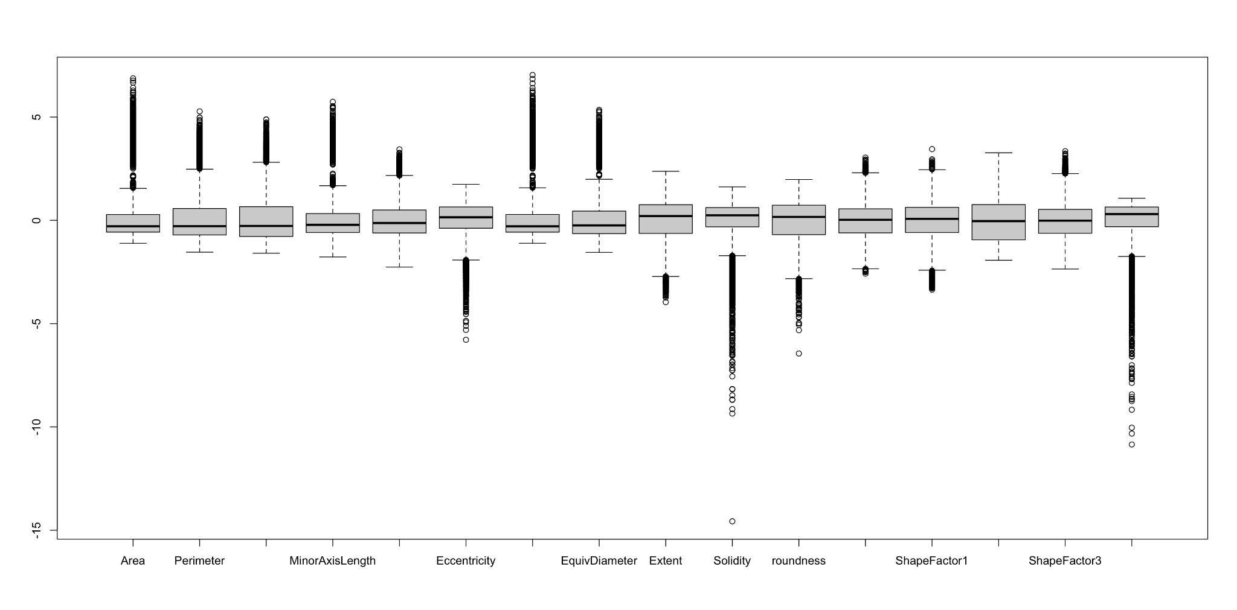
Boxplot with standardized Data

Slide 40
KNN vs K Means

Slide 41
KNN
K-Means
Supervised Learning
Unsupervised Learning
Uses labels to classifies the data
Analyzes the pooled data without label
Purpose
Purpose
Prediction of label for a new data point based on the neighbors
Cluster assignments for the data points solely based on features
Non-parametric
Non-parametric
K: number of neighbors used to classify a sample
K: number of presumed clusters in the unlabeled data

Slide 42
LDA vs PCA

Slide 43
LDA
PCA
Supervised Learning
Unsupervised Learning
Uses labels to classifies the data
Analyzes the pooled data without label
Classification
Dimension Reduction
Useful for predicting new observations and identifying essential features
Useful for data visualization, noise reduction, and feature extraction
Linear Functions
Linear Functions
First LD leads to the maximum separation of the data
First PC explains the most variance of the data

Slide 44


